Slide 1


Lecture 31
Produced by Dr. Worldwide
Welcome to the 305
~
~

Slide 2

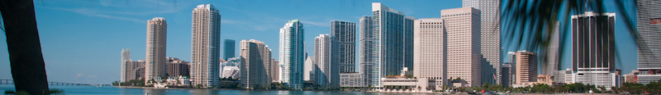
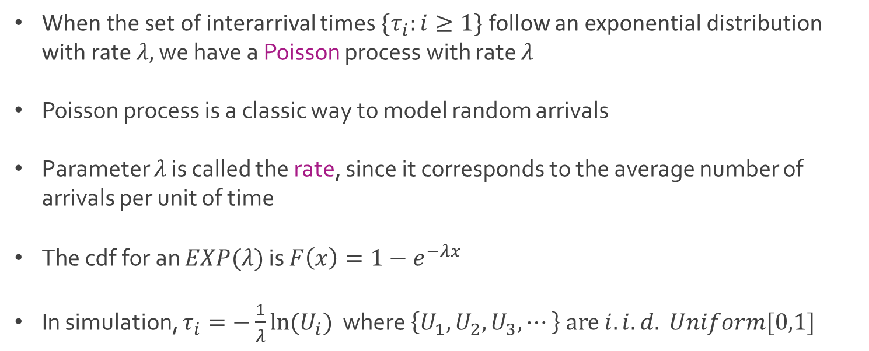
Poisson Process
When the set of interarrival times $\{τ_{i}:i≥1\}$ follow an exponential distribution with rate $λ,$ we have a Poisson process with rate $λ$
Poisson process is a classic way to model random arrivals
Parameter $λ$ is called the rate, since it corresponds to the average number of arrivals per unit of time
The cdf for an $EXP(λ)$ is $F\left(x\right)=1−e^{−λx}$
In simulation, $τ_{i}=−\frac{1}{λ}ln⁡(U_{i})$ where $\left\{U_{1},U_{2},U_{3},⋯\right\} are i.i.d. Uniform[0,1]$

Slide 3
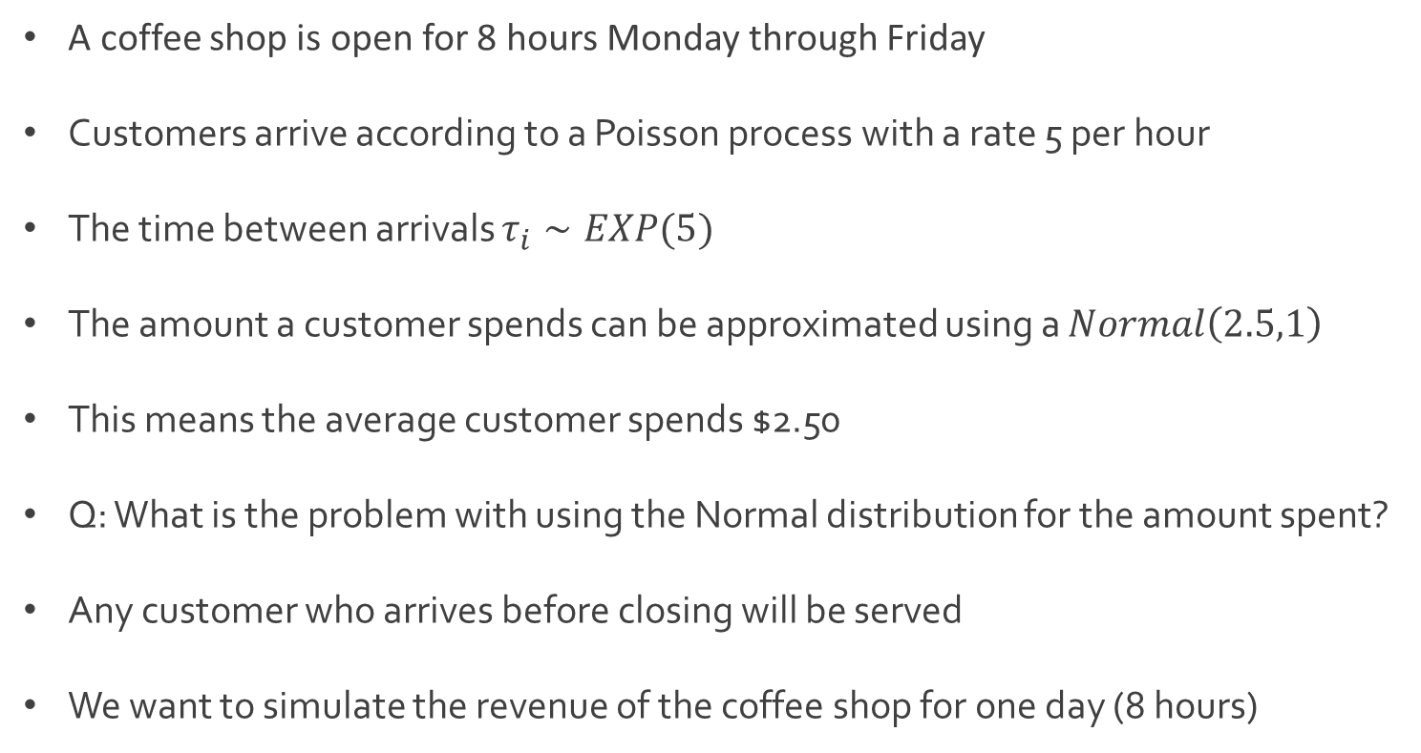
Ex: Coffee Shop Revenue
A coffee shop is open for 8 hours Monday through Friday
Customers arrive according to a Poisson process with a rate 5 per hour
The time between arrivals $τ_{i}∼EXP(5)$
The amount a customer spends can be approximated using a $Normal\left(2.5,1\right)$
This means the average customer spends $2.50
Q: What is the problem with using the Normal distribution for the amount spent?
Any customer who arrives before closing will be served
We want to simulate the revenue of the coffee shop for one day (8 hours)

Slide 4

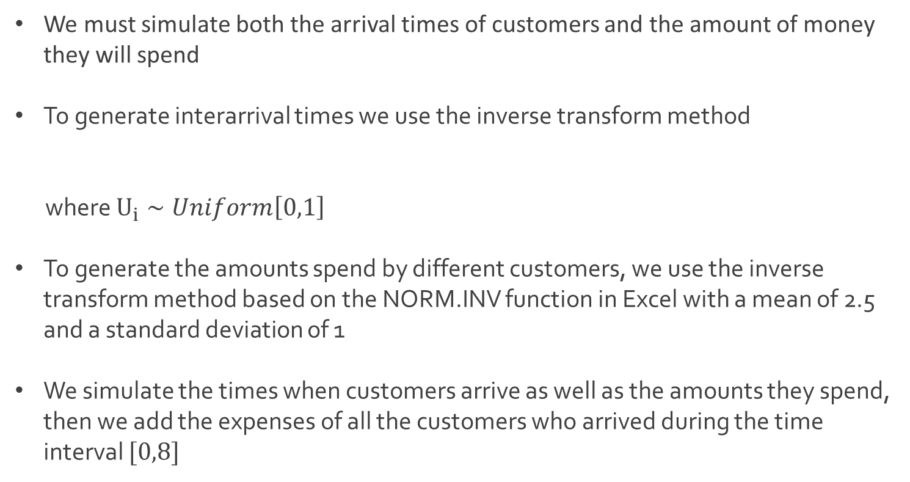
Ex: Coffee Shop Revenue
We must simulate both the arrival times of customers and the amount of money they will spend
To generate interarrival times we use the inverse transform method
where $U_{i}∼Uniform\left[0,1\right]$
To generate the amounts spend by different customers, we use the inverse transform method based on the NORM.INV function in Excel with a mean of 2.5 and a standard deviation of 1
We simulate the times when customers arrive as well as the amounts they spend, then we add the expenses of all the customers who arrived during the time interval $[0,8]$
$τ_{i}=−\frac{1}{5}ln⁡(U_{i})$

Slide 5
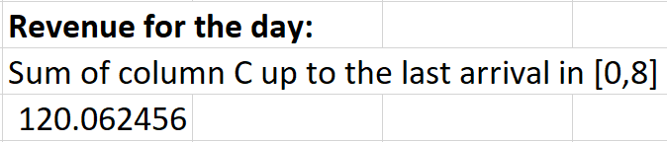
Ex: Coffee Shop Revenue
Download CoffeeShop.xlsx from the link Sheet 1 on the course website
Focus on tab named Revenue
Descriptions of columns
Column A contains interarrival times
Column B contains arrival times (notice the calculation)
Column C contains the amount spent (notice the use of MAX() function
Column D checks to see if the customer made it by closing
Simulated revenue for a single day

Slide 6

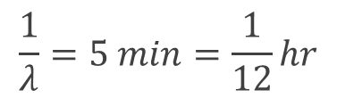
Ex: Coffee Shop Queue
Same coffee shop from previous example
We want to simulate the customer queue
Assume there is only one person at the cash register, and that this person both takes the order and prepares the coffee
Moment of silence for this poor worker
Each customer takes a random amount of time to be served, which we model as an exponential random variable with mean of 5 minutes (1/12 hour)
Customers are served in a first-come-first-serve basis
$$\frac{1}{λ}=5 min=\frac{1}{12}hr$$
$$λ=12$$

Slide 7

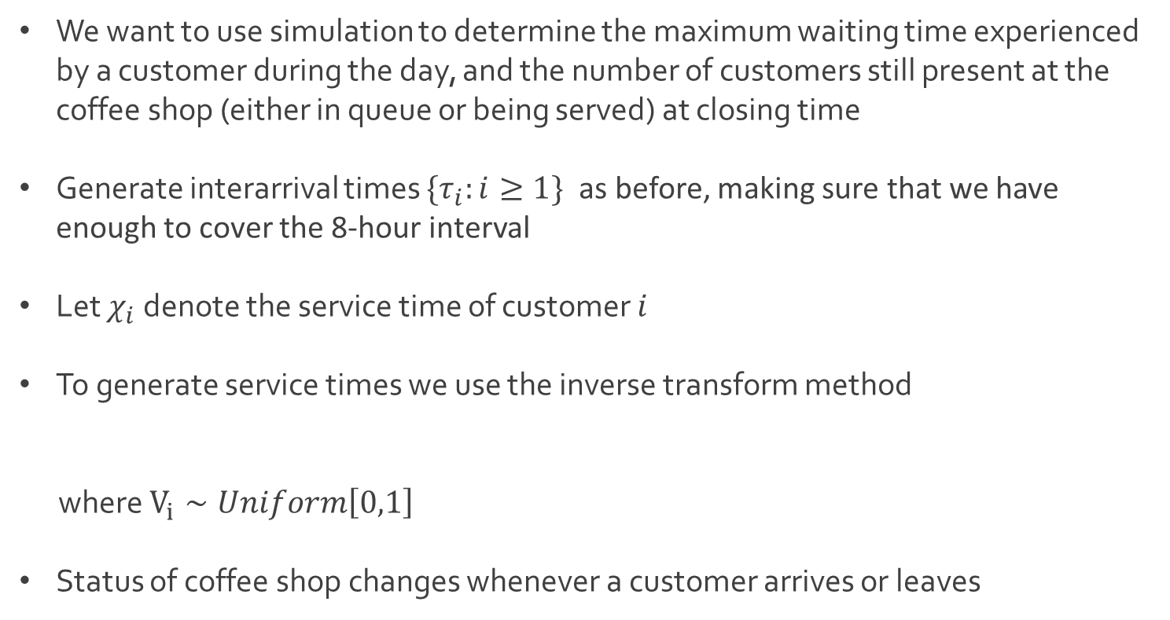
Ex: Coffee Shop Queue
We want to use simulation to determine the maximum waiting time experienced by a customer during the day, and the number of customers still present at the coffee shop (either in queue or being served) at closing time
Generate interarrival times $\{τ_{i}:i≥1\}$ as before, making sure that we have enough to cover the 8-hour interval
Let $χ_{i}$ denote the service time of customer $i$
To generate service times we use the inverse transform method
where $V_{i}∼Uniform\left[0,1\right]$
Status of coffee shop changes whenever a customer arrives or leaves
$χ_{i}=−\frac{1}{12}ln⁡(V_{i})$

Slide 8

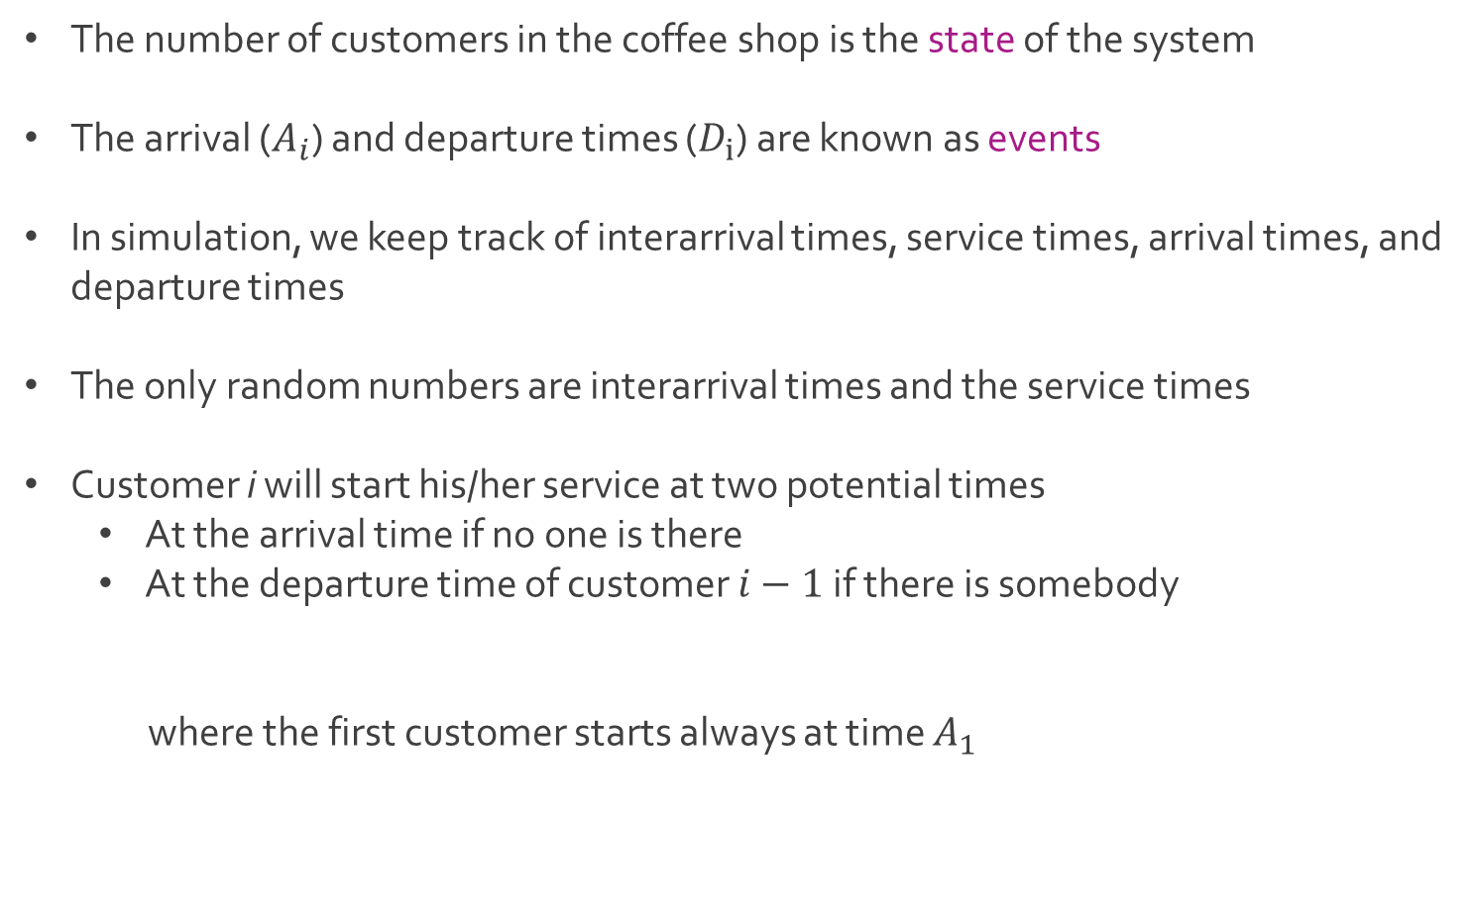
Ex: Coffee Shop Queue
The number of customers in the coffee shop is the state of the system
The arrival ($A_{i}$) and departure times ($D_{i}$) are known as events
In simulation, we keep track of interarrival times, service times, arrival times, and departure times
The only random numbers are interarrival times and the service times
Customer i will start his/her service at two potential times
At the arrival time if no one is there
At the departure time of customer $i−1$ if there is somebody
where the first customer starts always at time $A_{1}$

Slide 9
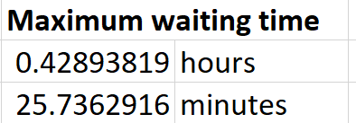
Ex: Coffee Shop Queue
The number of customers in the coffee shop at the end of the day is
Download CoffeeShop.xlsx from the link Sheet 1 on the course website
Focus on tab named Queue
Notice that departure time is the sum of arrival time and service time
Column H shows the waiting times which is the difference between the start of service and arrival time
$$Number of Arrivals in \left[0,8\right]−Number of Departures[0,8]$$

Slide 10
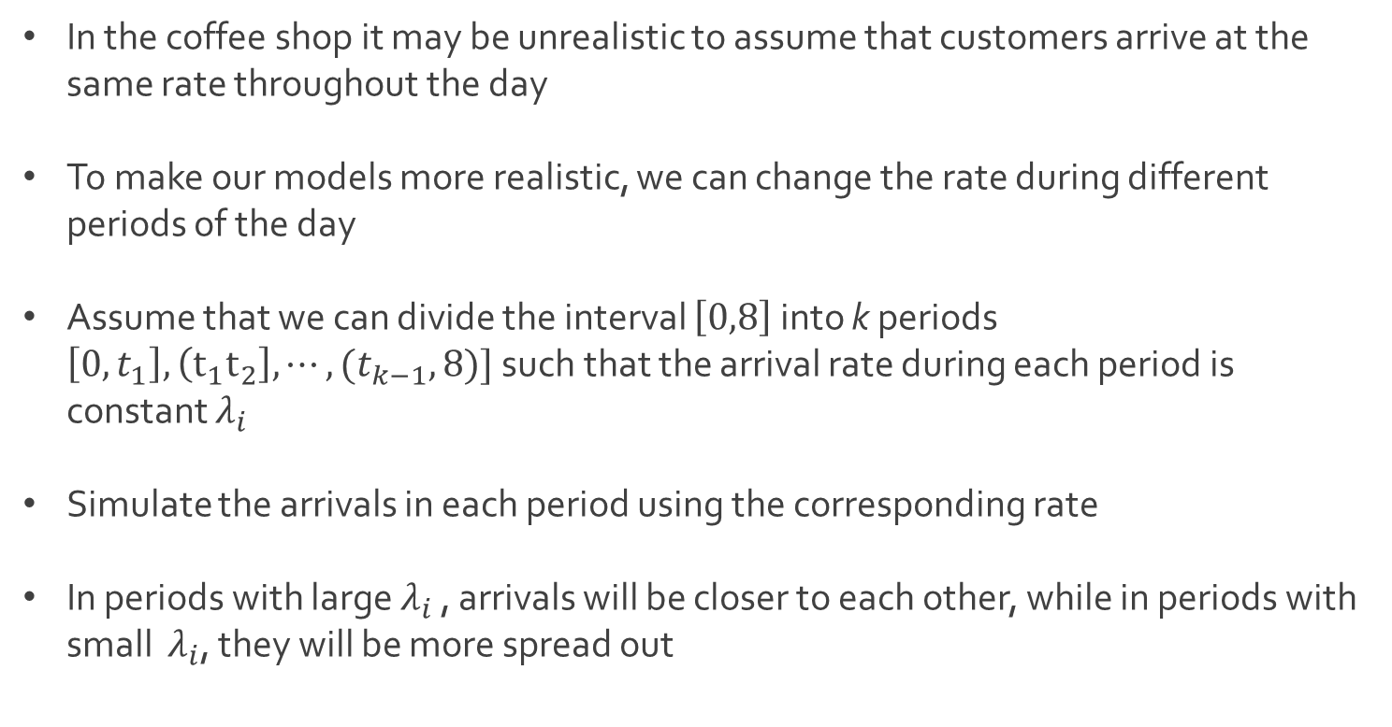
Ex: Coffee Shop Queue
In the coffee shop it may be unrealistic to assume that customers arrive at the same rate throughout the day
To make our models more realistic, we can change the rate during different periods of the day
Assume that we can divide the interval $\left[0,8\right]$ into k periods $\left[0,t_{1}\right], \left(t_{1}t_{2}\right], ⋯,(t_{k−1},8)]$ such that the arrival rate during each period is constant $λ_{i}$
Simulate the arrivals in each period using the corresponding rate
In periods with large $λ_{i}$ , arrivals will be closer to each other, while in periods with small $λ_{i}$, they will be more spread out

Slide 11

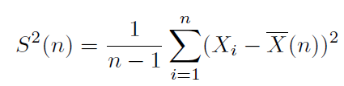


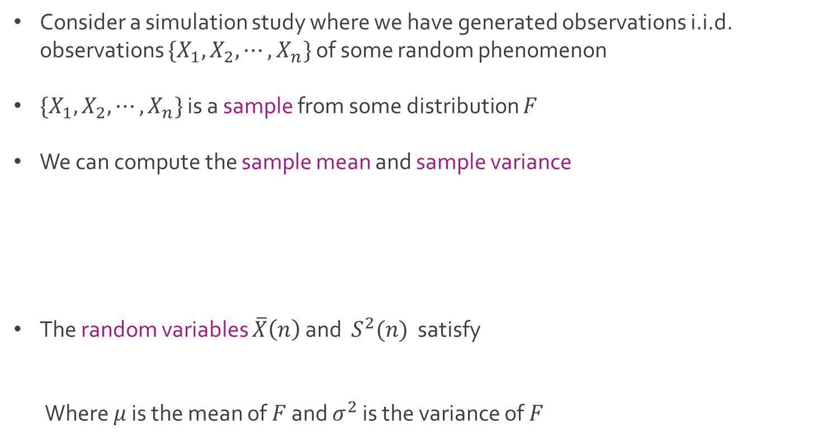
Sample Mean and Variance
Consider a simulation study where we have generated observations i.i.d. observations $\{X_{1},X_{2},⋯, X_{n}\}$ of some random phenomenon
$\{X_{1},X_{2},⋯, X_{n}\}$ is a sample from some distribution $F$
We can compute the sample mean and sample variance
The random variables $\overline{X}\left(n\right)$ and $S^{2}(n)$ satisfy
Where $μ$ is the mean of $F$ and $σ^{2}$ is the variance of $F$

Slide 12
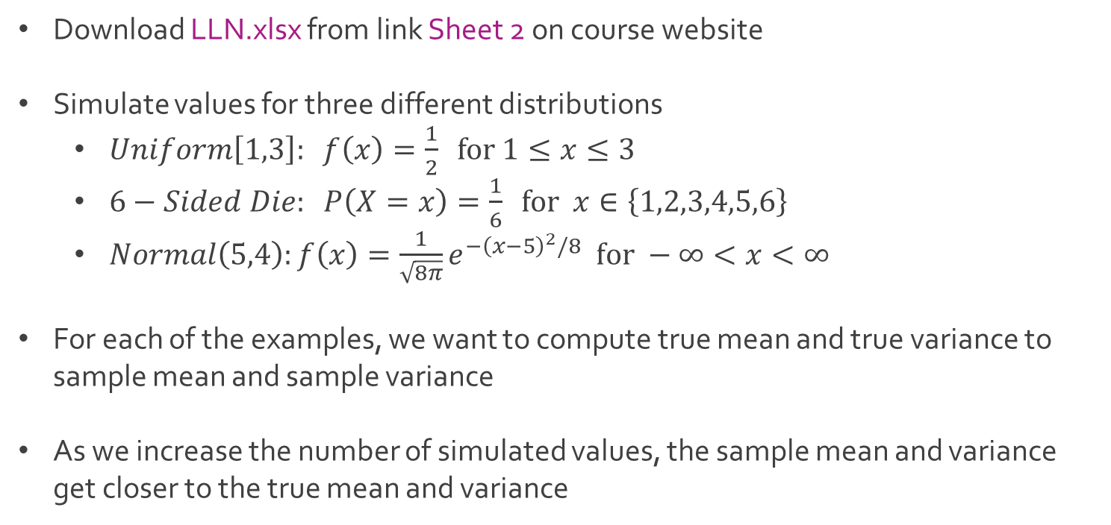
Ex: Tres Simulations
Download LLN.xlsx from link Sheet 2 on course website
Simulate values for three different distributions
$Uniform\left[1,3\right]: f\left(x\right)=\frac{1}{2} for 1≤x≤3$
$6−Sided Die: P\left(X=x\right)=\frac{1}{6} for x∈\left\{1,2,3,4,5,6\right\}$
$Normal\left(5,4\right):f\left(x\right)=\frac{1}{\sqrt{8π}}e^{−{\left(x−5\right)}^{2}/8} for −∞<x<∞$
For each of the examples, we want to compute true mean and true variance to sample mean and sample variance
As we increase the number of simulated values, the sample mean and variance get closer to the true mean and variance

Slide 13
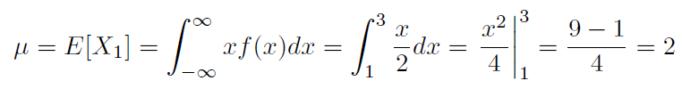
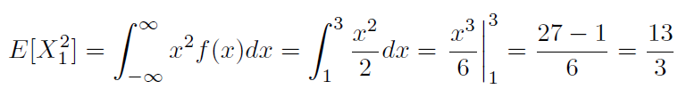


Ex: Tres Simulations
For the $Uniform\left[1,3\right]$

Slide 14
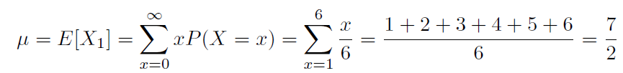




Ex: Tres Simulations
For the $6−Sided Die$
For the $Normal\left(5,4\right), μ=5 and σ^{2}=4$

Slide 15

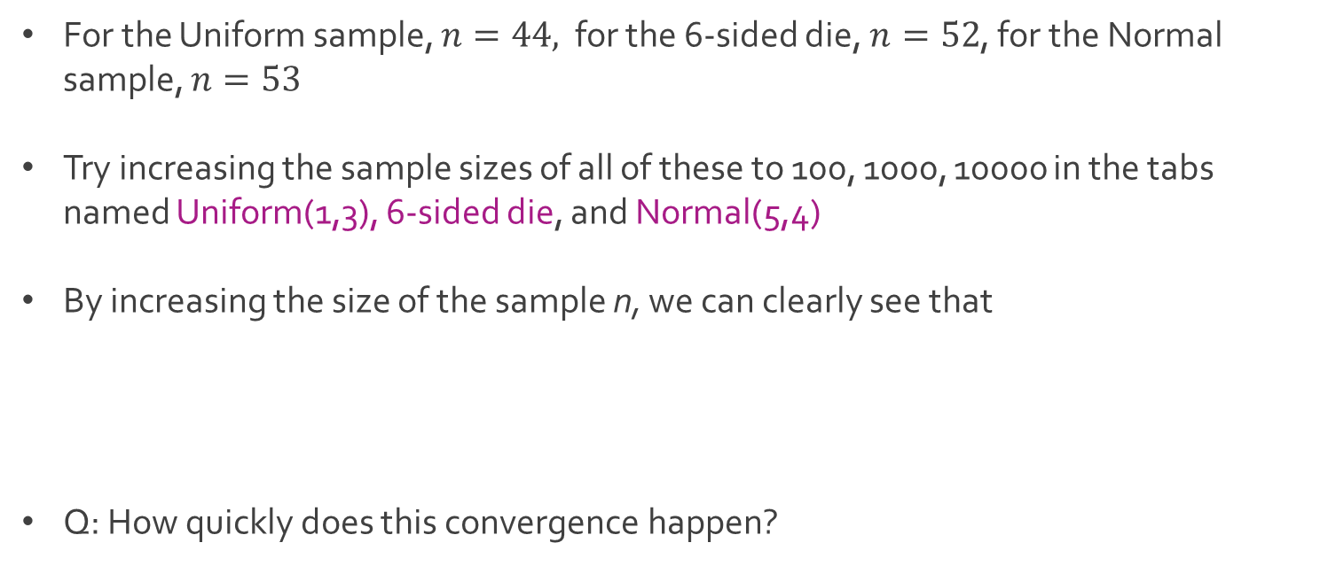
Ex: Tres Simulations
For the Uniform sample, $n=44,$ for the 6-sided die, $n=52$, for the Normal sample, $n=53$
Try increasing the sample sizes of all of these to 100, 1000, 10000 in the tabs named Uniform(1,3), 6-sided die, and Normal(5,4)
By increasing the size of the sample n, we can clearly see that
Q: How quickly does this convergence happen?

Slide 16

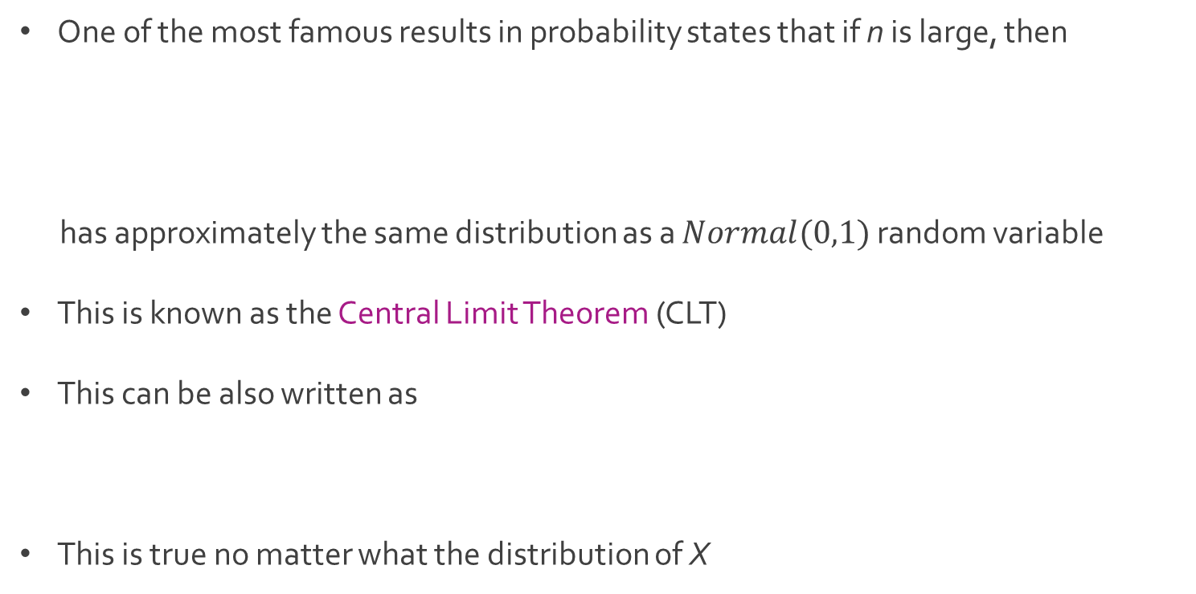
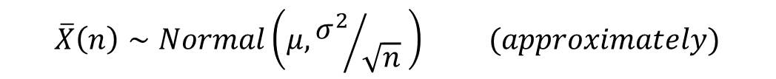
Central Limit Theorem
One of the most famous results in probability states that if n is large, then
has approximately the same distribution as a $Normal(0,1)$ random variable
This is known as the Central Limit Theorem (CLT)
This can be also written as
This is true no matter what the distribution of X
$$\overline{X}\left(n\right)∼Normal\left(μ, {σ^{2}}/{\sqrt{n}} \right) (approximately)$$

Slide 17

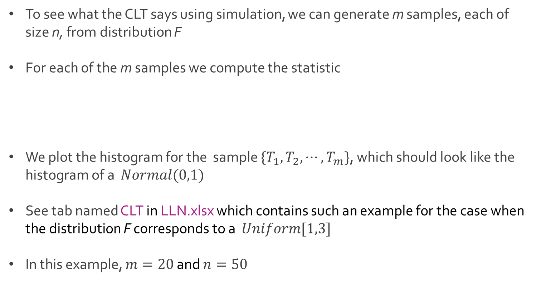
Ex: CLT
To see what the CLT says using simulation, we can generate m samples, each of size n, from distribution F
For each of the m samples we compute the statistic
We plot the histogram for the sample $\{T_{1},T_{2},⋯, T_{m}\}$, which should look like the histogram of a $Normal(0,1)$
See tab named CLT in LLN.xlsx which contains such an example for the case when the distribution F corresponds to a $Uniform[1,3]$
In this example, $m=20$ and $n=50$

Slide 18
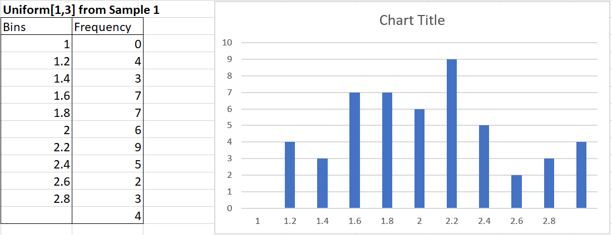
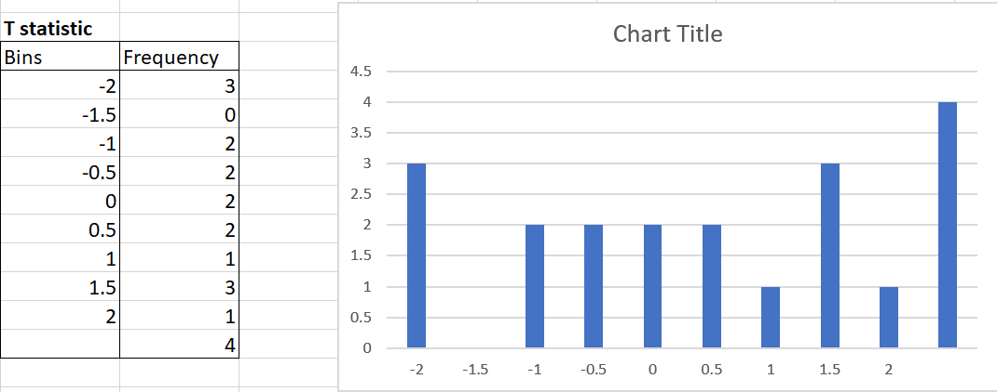

Ex: CLT
Histogram for the first sample
Histogram for $\left\{T_{1},T_{2},⋯, T_{m}\right\}$
Ideally, we need a lot larger m and need to compare different values of n

Slide 19




The End
Dale

